Slide 1
EEG-Based P300 Speller
Mid Term Report.
Name – samruddhi shinkar
Roll no- 250969.

Slide 2
Basic things we used
EEG is basically the measurement of the brain’s activity using the electrodes placed on the scalp of the person.
EEG signals are used to detect the changes in brain activity to diagnose various brain-diseases.
P300 is a positive voltage peak around 300 ms after detecting a target stimulus.

Slide 3
What are we doing in this project
This project develops a brain-controlled typing system. Users can select letters on a screen by focusing their attention, and the system detects their choice by reading a specific brainwave pattern called the P300.
The project takes us through the complete process of a BCI system: capturing brain signals (EEG), cleaning the data, training the machine learning model, and finally deploying it for real-time, mind-driven spelling.
The end goal is a functional speller system with a modular backend, so we can easily test and swap different ML models while maintaining stable real-time performance.

Slide 4
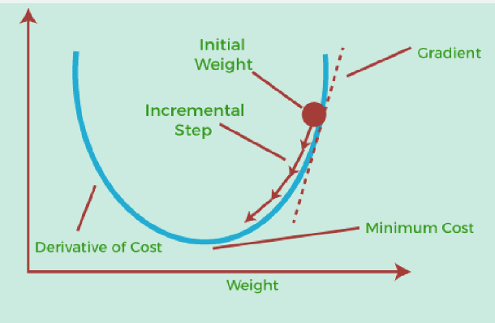
Machine learning
In ML, we majorly learnt about the basics.
In Supervised learning-types of Regression, Support Vector Machines(SVM), Decision trees, basic Random Forests,etc We learnt using forward propagation for all inputs of the independent variable to find the function(dependent variable) and evaluate the loss function and then finding the gradient descent of the loss function. (these steps are followed until the loss functions are minimized).
We also learnt different types of Neural Networks like Softmath Activation function Feed-forward, Convolutional Neural Network, etc.
We also learnt Feedback/Recurrent Neural Network(RNN) and its Paradigms Backpropagation of time through RNN and Long-Short Term Memor.

Slide 5
preprocessing: FILTERING AND RESAMPLING
A filter removes or attenuates parts of a signal. Usually, filters act on specific frequency ranges of a signal. For example, suppressing all frequency components above or below a certain cutoff value.
Artifacts that are restricted to a narrow frequency range can sometimes be repaired by filtering the data.
In MNE-Python, the resampling methods (raw.resample(), epochs.resample() and evoked.resample()) apply a low-pass filter to the signal to avoid aliasing, so you don’t need to explicitly filter it yourself first. This built-in filtering that happens when using raw.resample(), epochs.resample(), or evoked.resample() is a brick-wall filter applied in the frequency domain at the Nyquist frequency of the desired new sampling rate.
By default, MNE-Python resamples using method=“fft” or method=“polyphase”;method="polyphase" can also be faster than method="fft" in cases where the desired sampling rate is an integer factor different from the input sampling rate.
To avoid the reduction in temporal precision of events that comes with resampling a Raw object, and also avoid the edge artifacts that come with filtering an Epochs or Evoked object, the best practice is to.

Slide 6
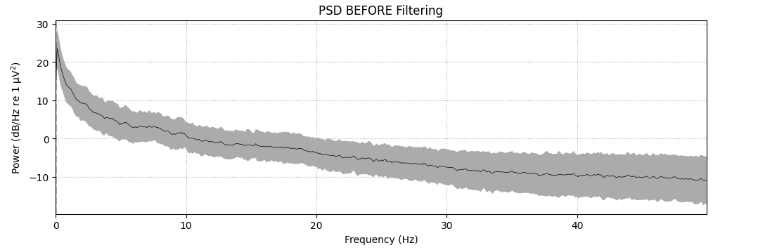
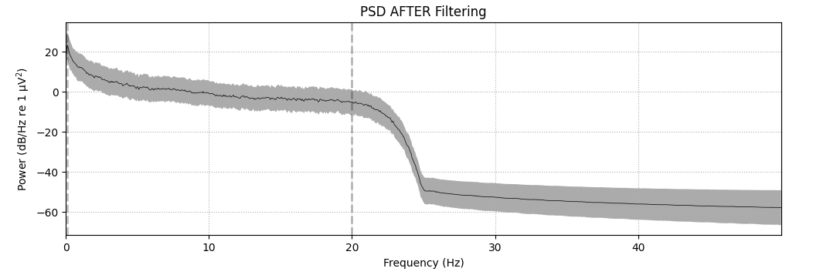

Slide 7
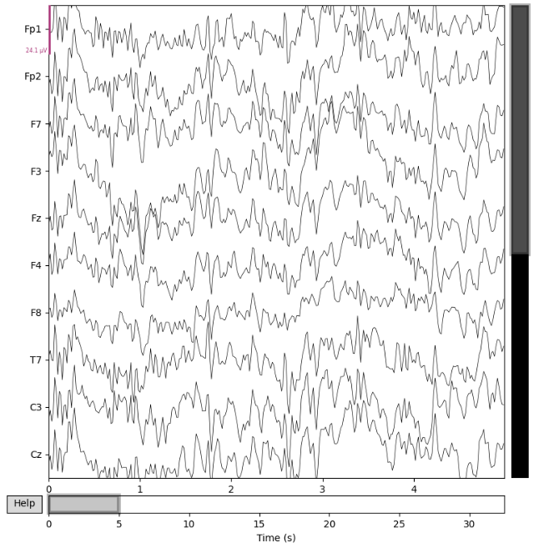
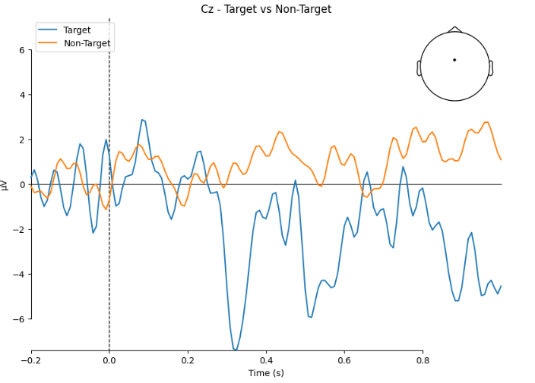
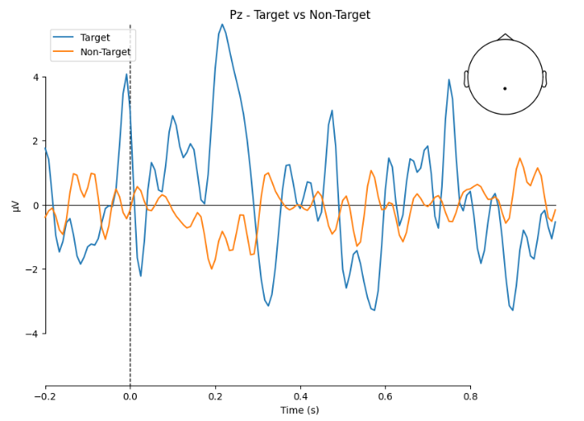

Slide 8
EPOCH extraction
Epoch Extraction is the process of dividing a continuous EEG signal into smaller, time-locked segments centered around specific events of interest. In simpler terms, it's like cutting a long movie into short clips that all start at the exact same moment relative to something important that happened.
We record continuous EEG data while the user looks at the speller matrix.
Every time a letter flashes (our stimulus), we mark that exact timestamp in the data as an "event" or "trigger."
We create a window around each event, typically from 100ms before the stimulus to about 600-1000ms after.
We cut out segments of the data using these windows, creating multiple "epochs" - one for each flash event.

Slide 9
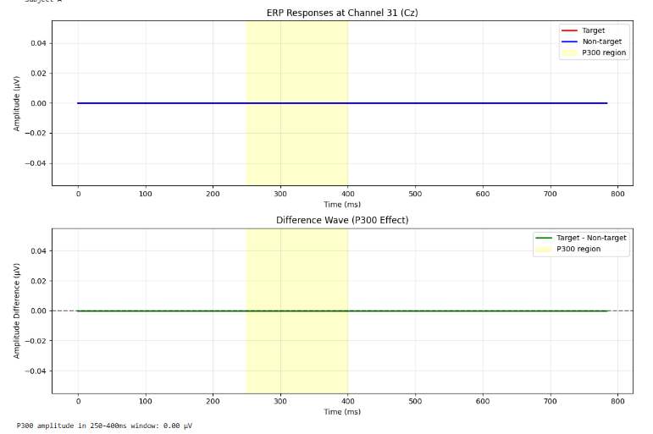
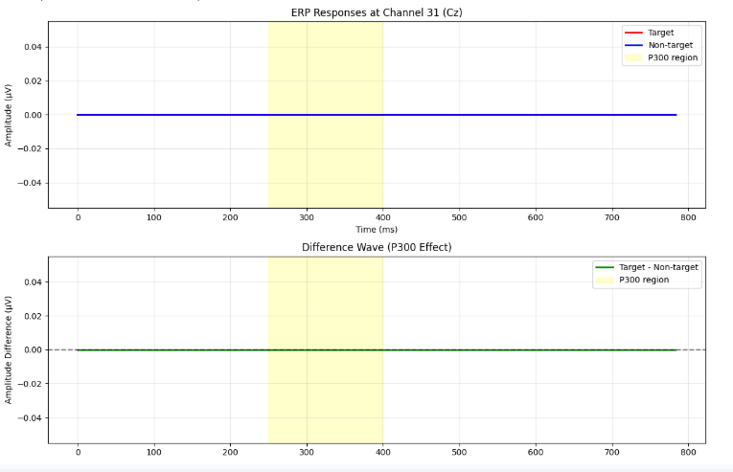

Slide 10
INDEPENDENT COMPONENTS ANALYSIS
ICA is a blind source separation technique that separates EEG signals into statistically independent components. The idea is that the raw EEG recorded at each electrode is mixture of underlying sources.
MNE-Python implements three different ICA algorithms: fastica (the default), picard, and infomax. After visualizing the Independent Components (ICs) and excluding any that capture artifacts you want to repair, the sensor signal can be reconstructed using the ICA object’s apply method. By default, signal reconstruction uses all of the ICs (less any ICs listed in ICA.exclude) plus all of the PCs that were not included in the ICA decomposition (i.e., the “PCA residual”).

Slide 11
Plotting topographic maps of evoked data
We plot evoked topographies using mne.Evoked.plot_topomap(). The first argument, times allows to specify time instants (in seconds!) for which topographies will be shown. We select timepoints from 50 to 150 ms with a step of 20ms and plot magnetometer data.
We can also look at the effects of interpolating our data. Perhaps, we might have data per channel such as the impedance of each electrode that we don’t want interpolated, or we just want to visualize the data without interpolation as a sanity check. We can use image_interp='nearest' to prevent any interpolation or image_interp='linear' to do a linear interpolation instead of the default cubic interpolation.

Slide 12
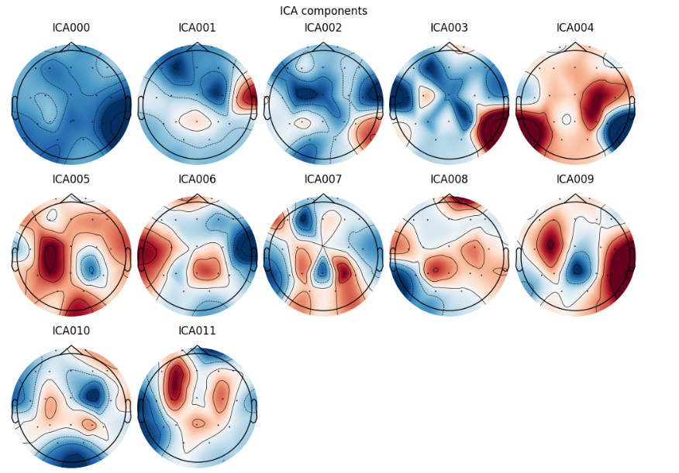

Slide 13
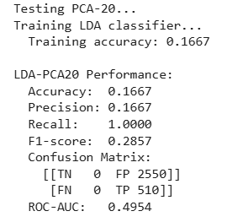
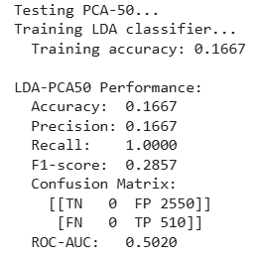
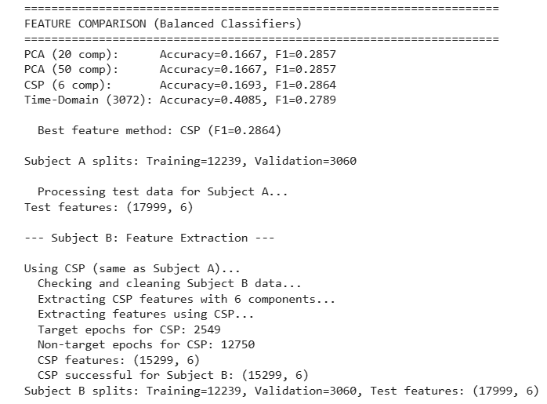
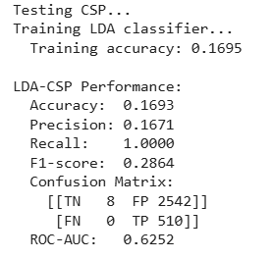
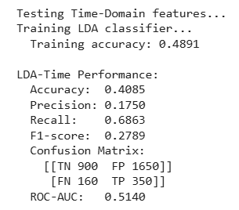

Slide 14
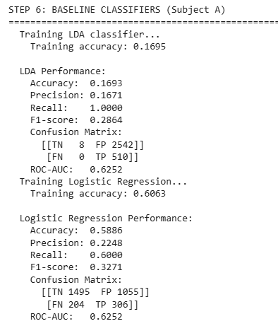
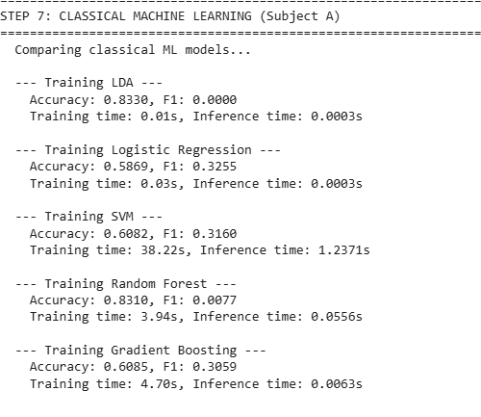

Slide 15
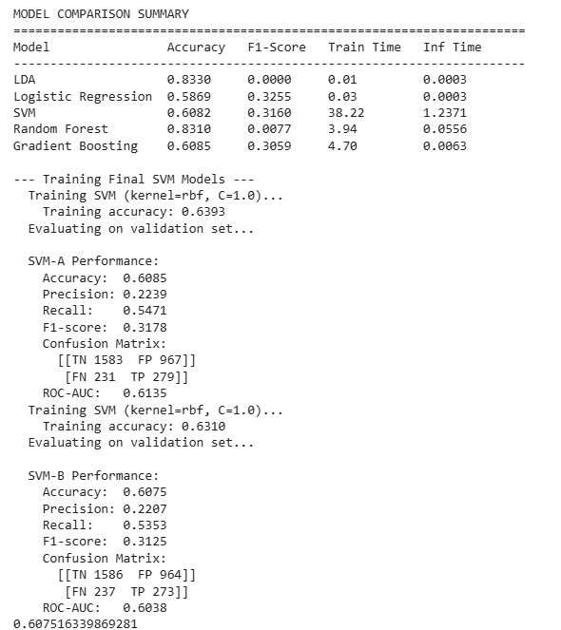

Slide 16
Challenges faced by me
Since I am a first year student doing pyton for the first time, it was quite difficult for me to understand the ML codes etc written in python though Manan taught ML concepts very well, it took time for me to understand those codes and write them at the same time, though I had AI to help me I felt that I was still lagging behind for quite some time.

